Slide 1
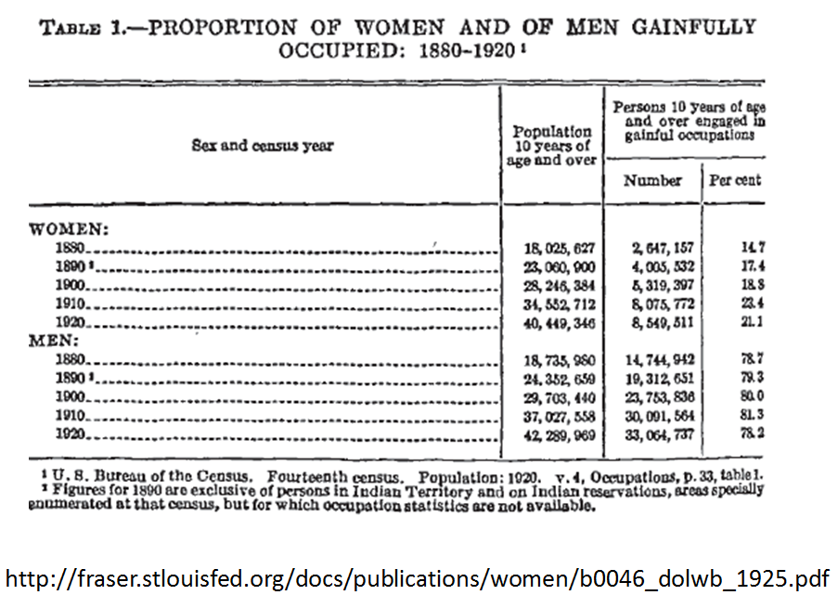
Barbie® in the Labor Force

Slide 2
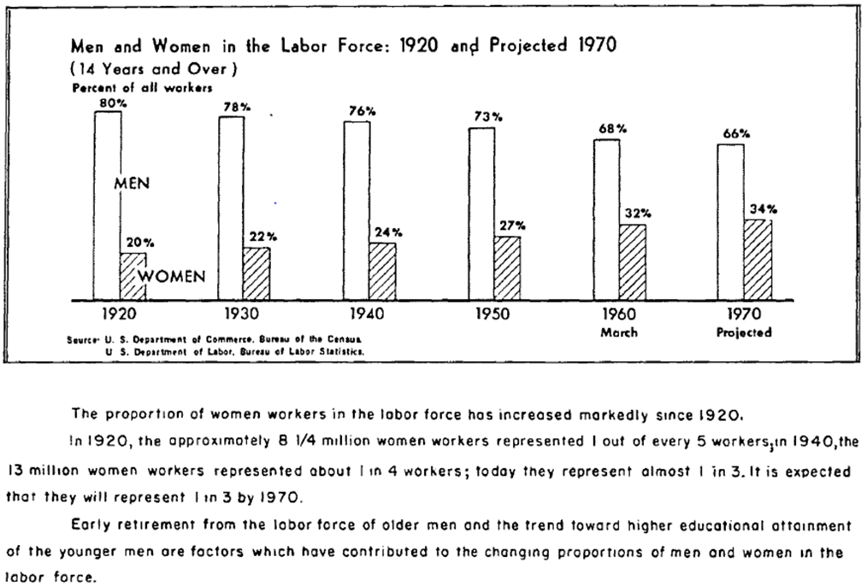
Barbie® in the Labor Force
Source: http://fraser.stlouisfed.org/docs/publications/women/highlights_dolwb_1960.pdf

Slide 3
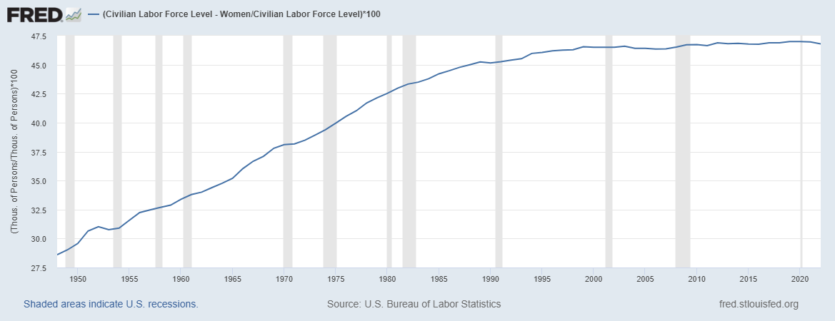
Barbie® in the Labor Force
https://fred.stlouisfed.org/series/LNS11000002
Civilian Labor Force Participation Rate: Women
(LNS11300002), Percent, Annual, Average, Seasonally Adjusted

Slide 4
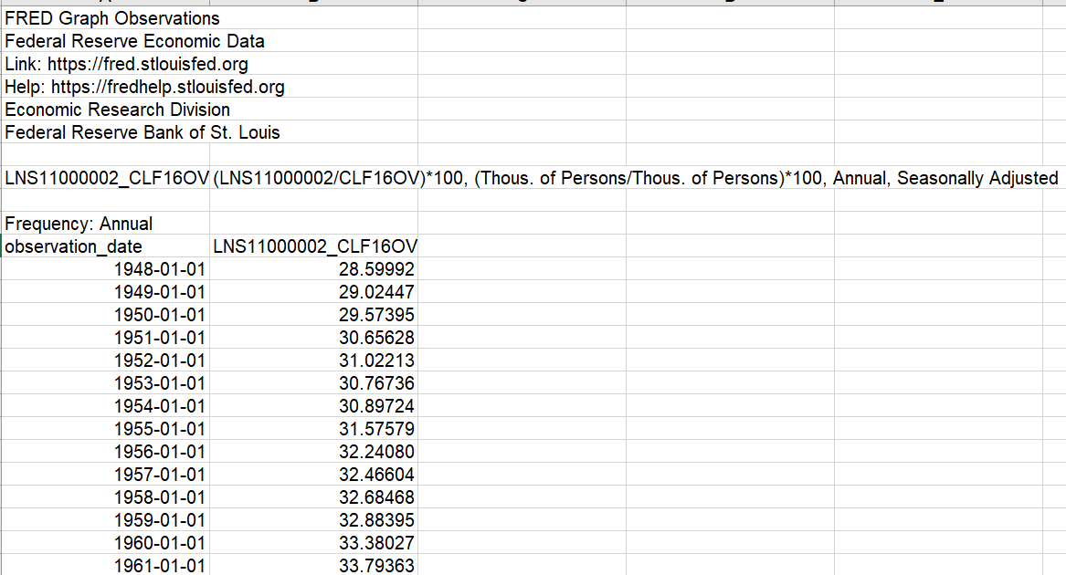
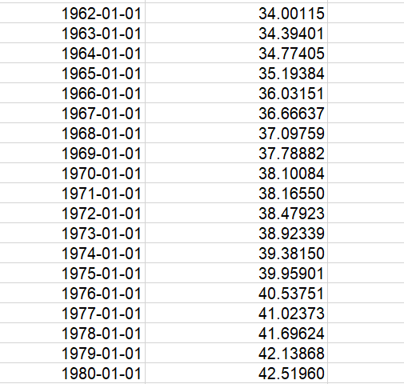
Barbie® in the Labor Force
https://fred.stlouisfed.org/series/LNS11000002
Civilian Labor Force Participation Rate: Women
(LNS11300002), Percent, Annual, Average, Seasonally Adjusted
Notes:
Source:
U.S. Bureau of Labor Statistics
Release:
Employment Situation
Units:
Percent, Seasonally Adjusted
Frequency:
Monthly
To obtain estimates of women worker employment, the ratio of weighted women employees to the weighted all employees in the sample is assumed to equal the same ratio in the universe. The current month's women worker ratio, thus, is estimated and then multiplied by the all-employee estimate. The weighted-difference-link-and-taper formula (described in the source) is used to estimate the current month's women worker ratio. This formula adds the change in the matched sample's women worker ratio (the weighted-difference link) to the prior month's estimate, which has been slightly modified to reflect changes in the sample composition (the taper).The series comes from the 'Current Population Survey (Household Survey)'The source code is: LNS11300002
U.S. Bureau of Labor Statistics,
Labor Force Participation Rate - Women [LNS11300002],
retrieved from FRED,
Federal Reserve Bank of St. Louis;
https://fred.stlouisfed.org/series/LNS11300002,
January 24, 2023.

Slide 5
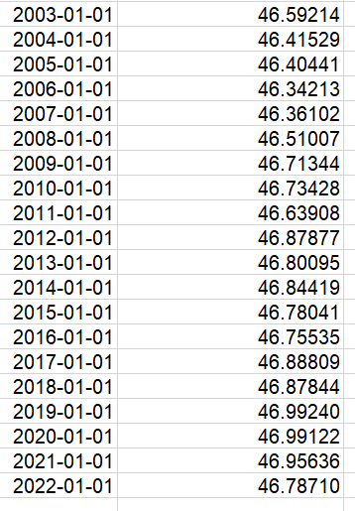
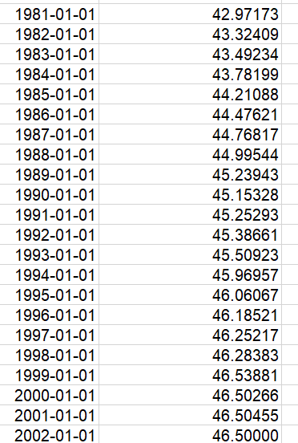
Barbie® in the Labor Force
https://fred.stlouisfed.org/series/LNS11000002
Civilian Labor Force Participation Rate: Women
(LNS11300002), Percent, Annual, Average, Seasonally Adjusted

Slide 6
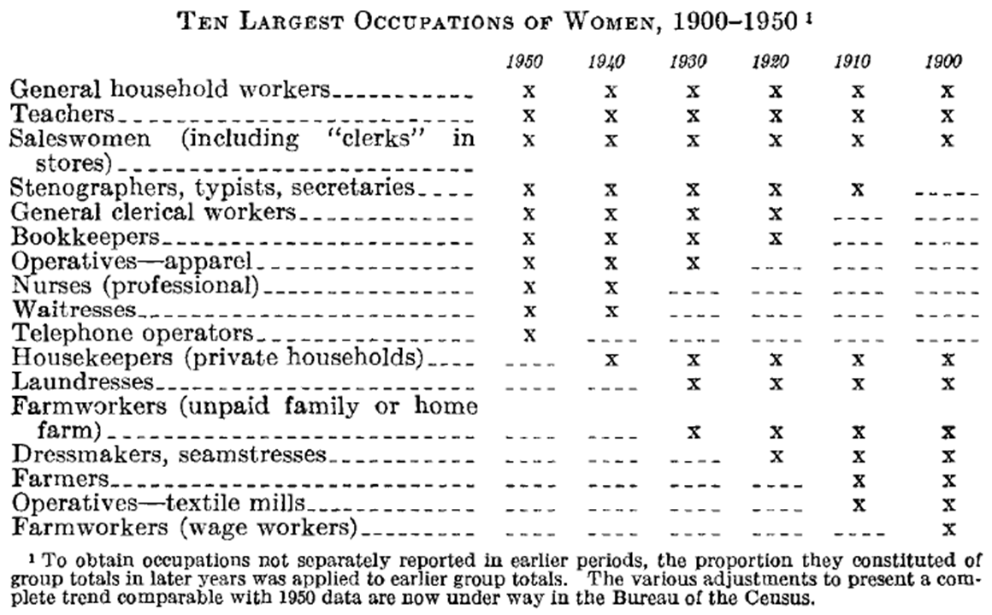
Barbie® in the Labor Force
Source: http://fraser.stlouisfed.org/docs/publications/women/b0253_dolwb_1954.pdf.

Slide 7
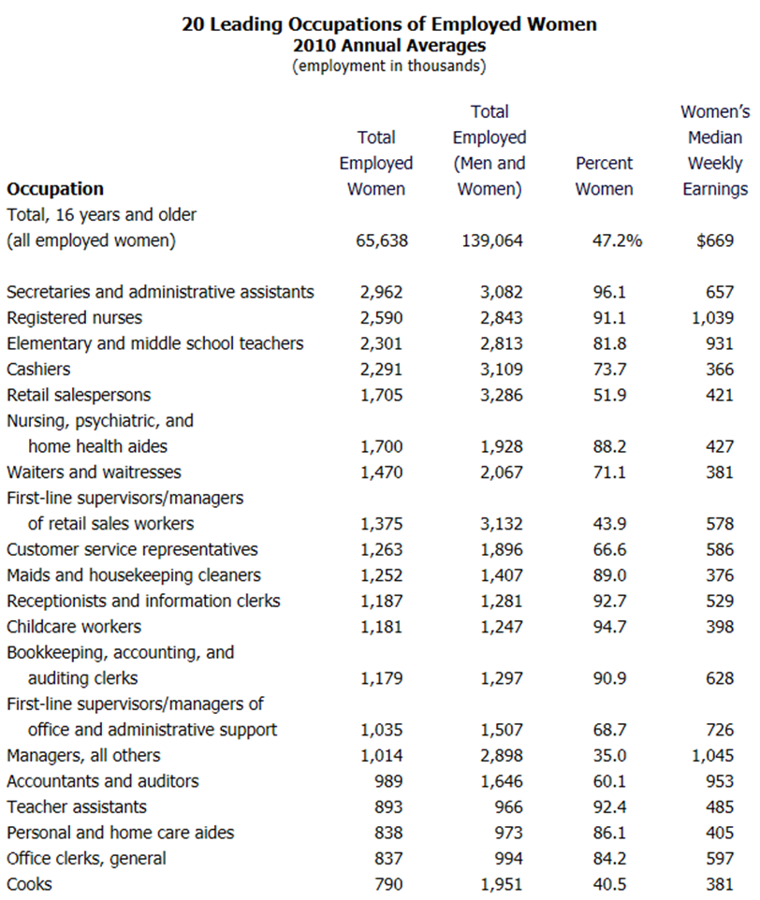
Barbie® in the Labor Force
Source: http://www.dol.gov/wb/factsheets/20lead2010.htm.

Slide 8
Barbie® in the Labor Force
1959
Fashion Model
1960
Fashion Editor
1961
Singer
Nurse
Ballerina
Stewardess
1963
Career Girl
1965
Student Teacher
Astronaut
1973
Surgeon
1975
Olympic Skier
1985
Veterinarian
1986
Astronaut (in pink)
1991
Naval Petty Officer
1992
Presidential Candidate
Business Executive
Marine Corp Sergeant
1993
Army Medic
1995
Firefighter
1996
Olympic Gymnast
1997
Dentist
1998
WNBA Player
1999
Airline Pilot
Business Executive
Women's World Cup Soccer Player
2000
Olympic Swimmer
2002
Art Teacher
2003
Producer
2004
Presidential Candidate
2010
Race Car Driver

Slide 9
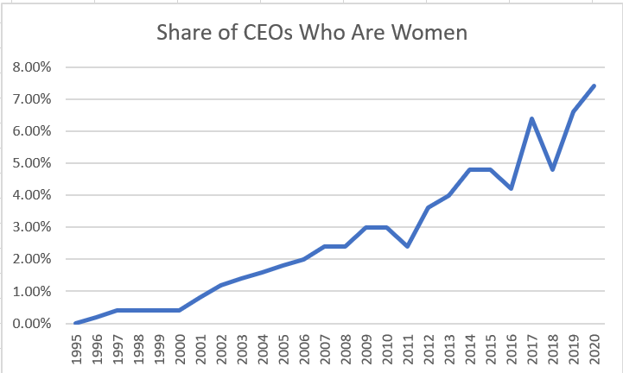
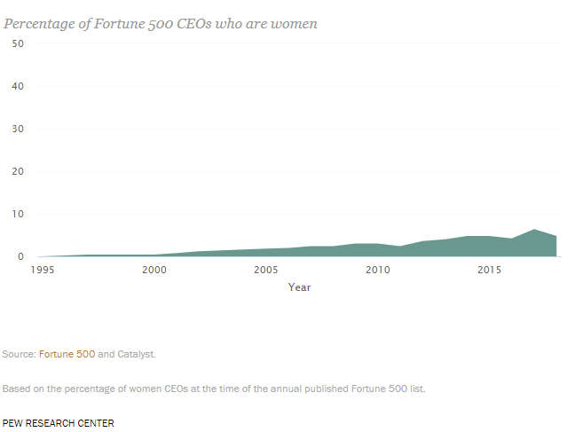
Barbie® in the Labor Force

Slide 10
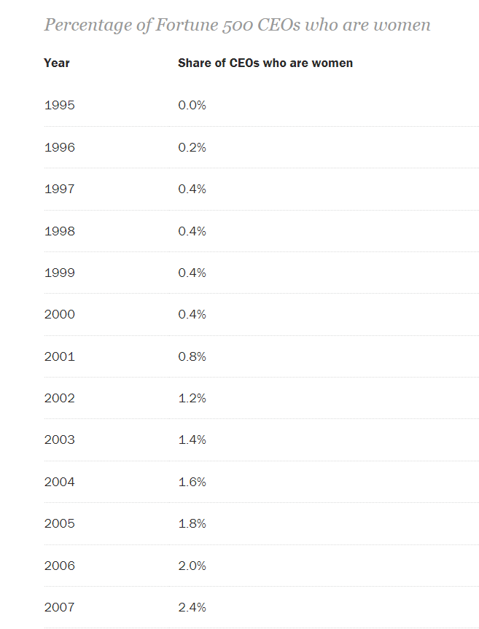
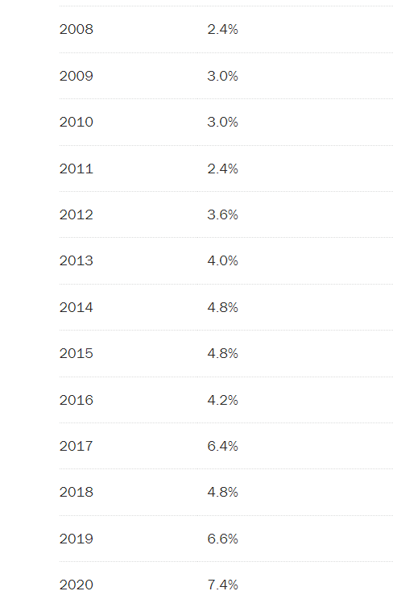
As of 2023, the share of CEOs who are women is 10.6%.

Slide 11
Barbie® in the Labor Force
Bridging the Gender Gap: Why More Women Aren't Computer Scientists, Engineers
Finding Ada
Sketch of the Analytical Engine
Sketch of the Analytical Engine (more readable)
Letter from DeMorgan to Lady Byron (Ada's mother)

Slide 12
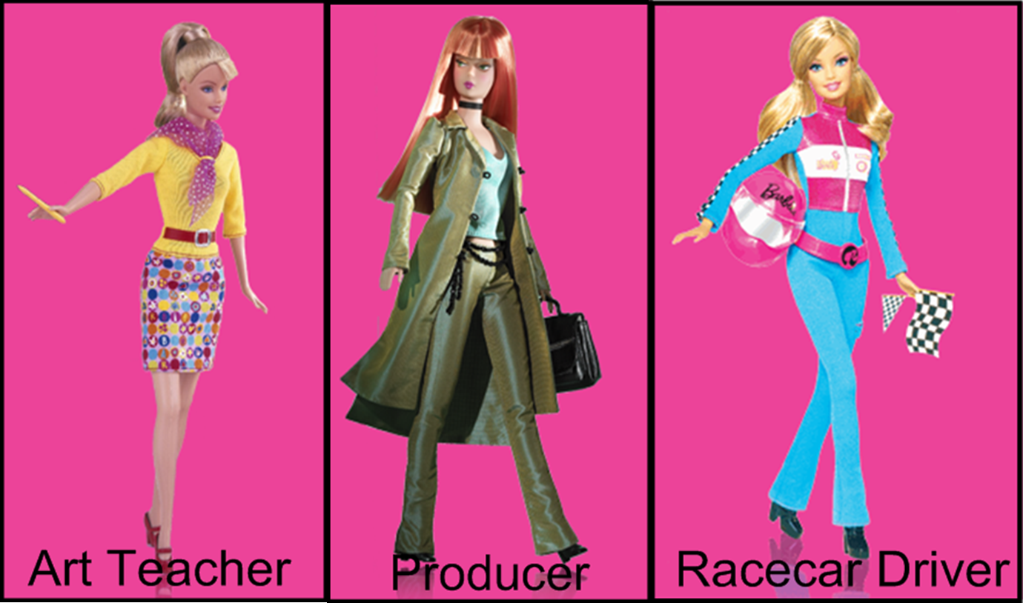
“Barbie®” photographs © Mattel, Inc. 2012. All rights reserved. All “Barbie®” images appear courtesy of Mattel, Inc.

Slide 13
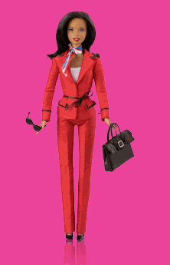
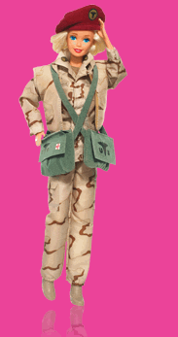
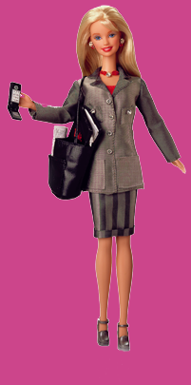
Presidential Candidate
Business Executive
Army Medic
“Barbie®” photographs © Mattel, Inc. 2012. All rights reserved. All “Barbie®” images appear courtesy of Mattel, Inc.

Slide 14
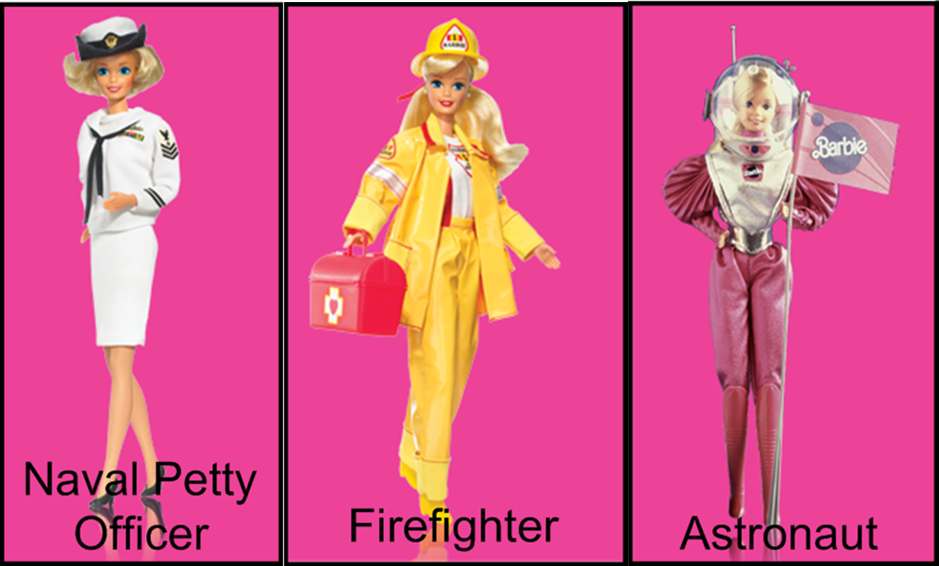
“Barbie®” photographs © Mattel, Inc. 2012. All rights reserved. All “Barbie®” images appear courtesy of Mattel, Inc.

Slide 15
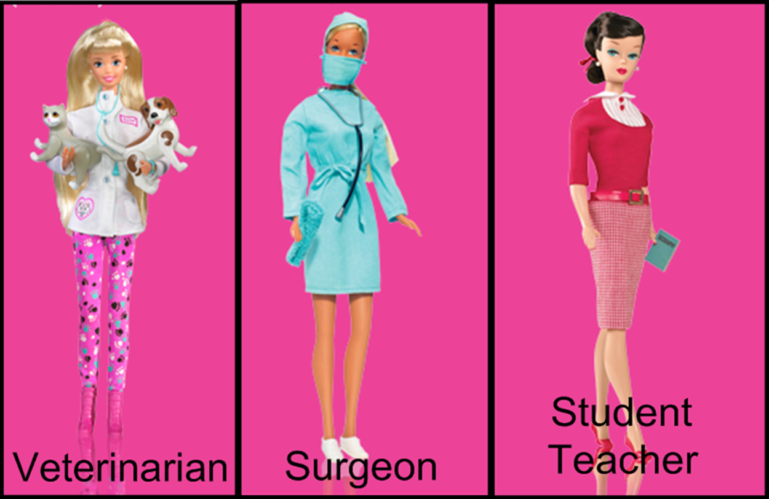
“Barbie®” photographs © Mattel, Inc. 2012. All rights reserved. All “Barbie®” images appear courtesy of Mattel, Inc.

Slide 16
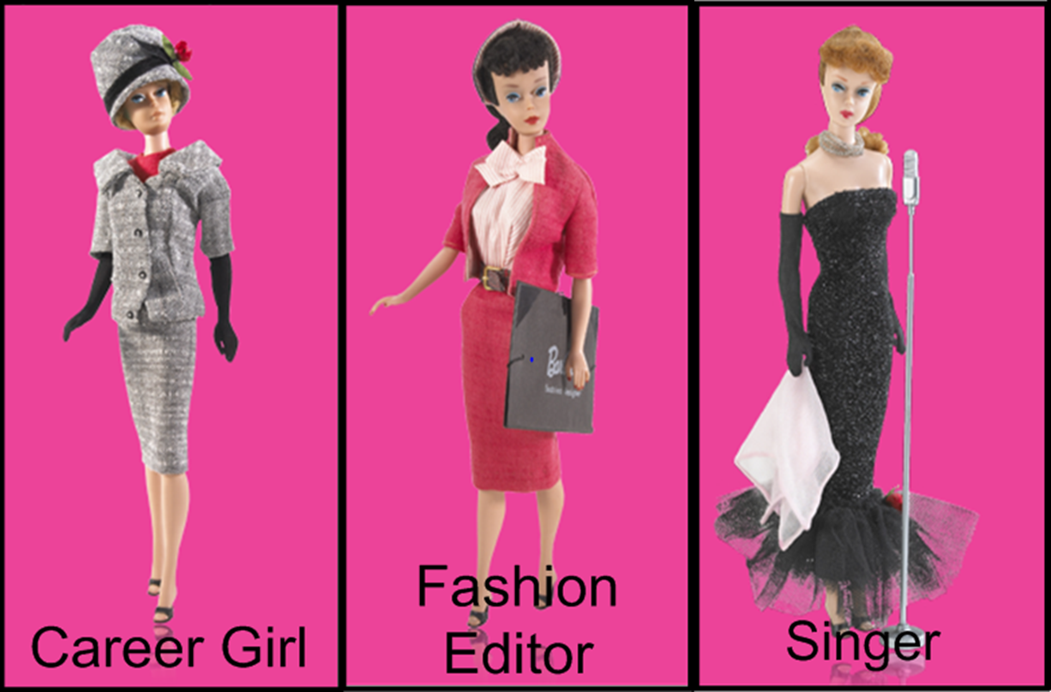
“Barbie®” photographs © Mattel, Inc. 2012. All rights reserved. All “Barbie®” images appear courtesy of Mattel, Inc.

Slide 17
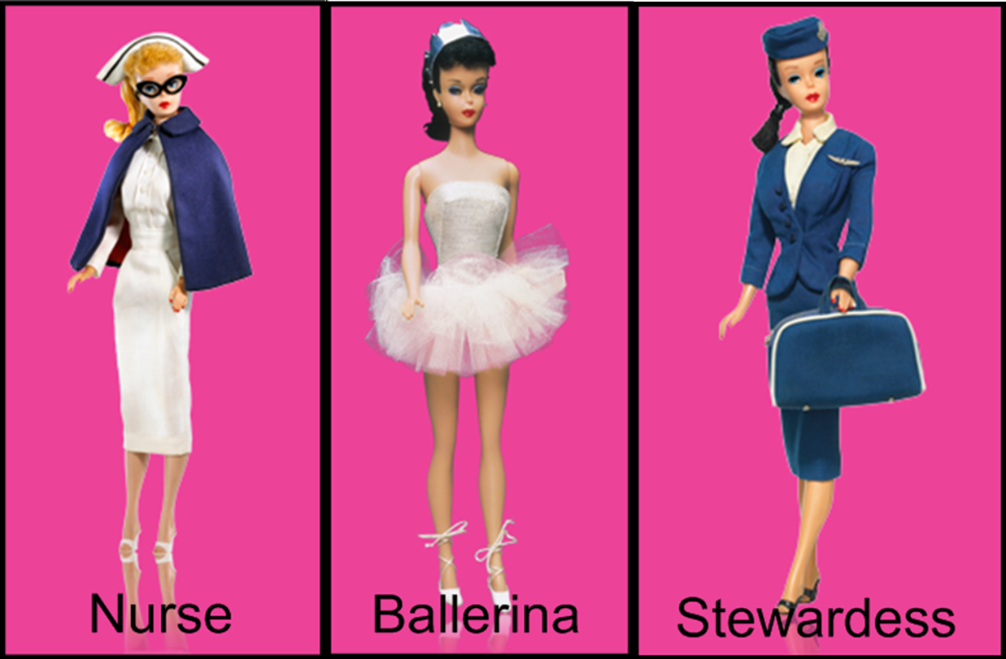
“Barbie®” photographs © Mattel, Inc. 2012. All rights reserved. All “Barbie®” images appear courtesy of Mattel, Inc.

Slide 18
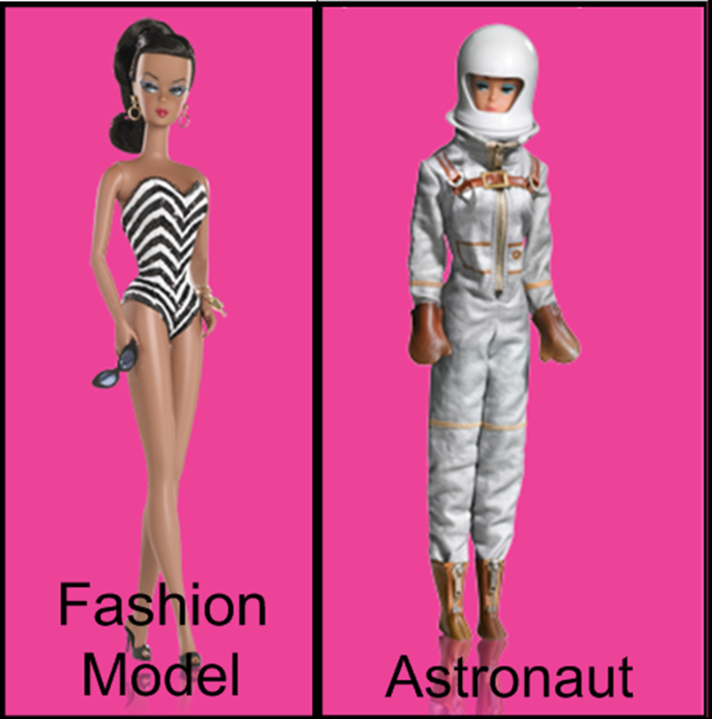
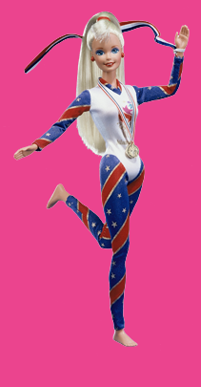
Olympic Gymnast
“Barbie®” photographs © Mattel, Inc. 2012. All rights reserved. All “Barbie®” images appear courtesy of Mattel, Inc.

Slide 19
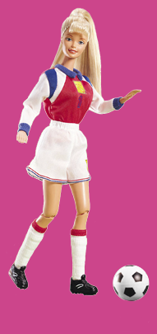
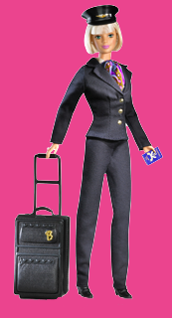
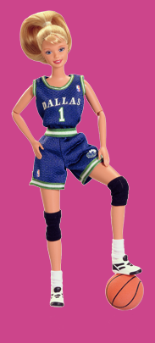
Soccer Player
WNBA Player
Airline Pilot
“Barbie®” photographs © Mattel, Inc. 2012. All rights reserved. All “Barbie®” images appear courtesy of Mattel, Inc.

Slide 20

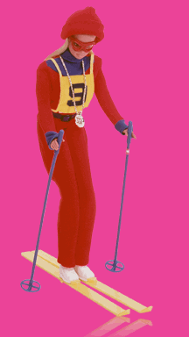
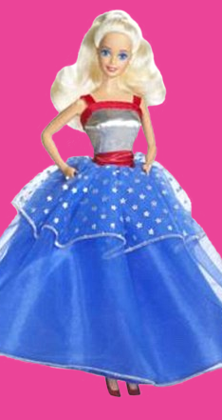
Olympic Skier
Presidential Candidate
Dentist
“Barbie®” photographs © Mattel, Inc. 2012. All rights reserved. All “Barbie®” images appear courtesy of Mattel, Inc.

Slide 21
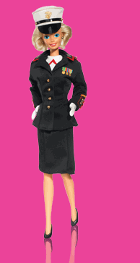
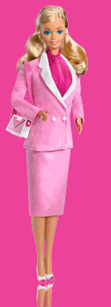
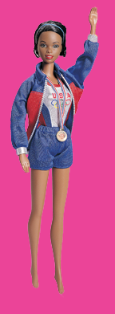
Marine Corp Sergeant
Business Executive
Olympic Swimmer
“Barbie®” photographs © Mattel, Inc. 2012. All rights reserved. All “Barbie®” images appear courtesy of Mattel, Inc.

Slide 22



Olympic Swimmer
Marine Corp Sergeant
Business Executive
“Barbie®” photographs © Mattel, Inc. 2012. All rights reserved. All “Barbie®” images appear courtesy of Mattel, Inc.

Slide 23

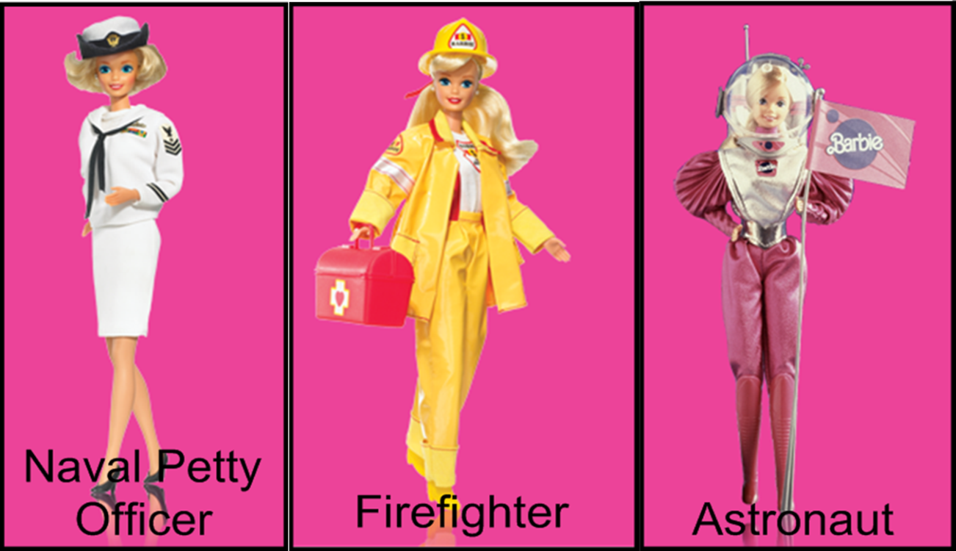
Presidential Candidate
Army Medic
“Barbie®” photographs © Mattel, Inc. 2012. All rights reserved. All “Barbie®” images appear courtesy of Mattel, Inc.

Slide 24
Olympic Gymnast
Presidential Candidate
Olympic Skier
Airline Pilot
Dentist
WNBA Player
Soccer Player
Business Executive
“Barbie®” photographs © Mattel, Inc. 2012. All rights reserved. All “Barbie®” images appear courtesy of Mattel, Inc.

