Slide 1
Externalities: There’s No Use Crying Over Spillovers
Note: On slides 3, 5, 7, & 9 in presentation mode students may slide the graph pieces on a separate monitor in the normal/edit view.

Slide 2
Supply & Demand Graph
Price
Supply
P
Demand
Quantity
Q

Slide 3
Marginal Benefits & Costs
Price
= Marginal Private Cost (MPC)
Supply
= Marginal Social Cost (MSC)
P
= Marginal Private Benefit (MPB)
Demand
= Marginal Social Benefit (MSB)
Quantity
Q

Slide 4
Negative Production Externality
Price
Demand = Marginal Private Benefit (MPB)
Marginal Social Benefit (MSB)
Supply = Marginal Private Cost (MPC)
Marginal Social Cost (MSC)
DWL
Marginal external cost
P_{S}
P_{M}
Quantity
Q_{S}
Q_{M}
GRAPH PIECES

Slide 5
Negative Production Externality—Answer Key
Price
Marginal Social Cost (MSC)
TAKEAWAYS
Third party is hurt by production
Private costs are less than what’s incurred by the society
MPC < MSC at market equilibrium quantity, Q_{M}
Society wants LESS quantity to be exchanged, Q_{S} < Q_{M}
Supply = Marginal Private Cost (MPC)
Marginal external cost
DWL
P_{S}
P_{M}
Demand = Marginal Private Benefit (MPB)
Marginal Social Benefit (MSB)
Quantity
Q_{S}
Q_{M}

Slide 6
Negative Consumption Externality
Price
Demand = Marginal Private Benefit (MPB)
Supply = Marginal Private Cost (MPC)
Marginal Social Cost (MSC)
Marginal Social Benefit (MSB)
Marginal external Benefit
DWL
P_{S}
P_{M}
Quantity
Q_{S}
Q_{M}
GRAPH PIECES

Slide 7
Negative Consumption Externality—Answer Key
Price
TAKEAWAYS
3rd party is hurt by consumption
Private benefits are more than how much society benefits
MPB > MSB at market equilibrium quantity, Q_{M}
The society doesn’t benefit as much
Society wants LESS to be exchanged, Q_{S} < Q_{M}
Supply = Marginal Private Cost (MPC)
Marginal Social Cost (MSC)
P_{M}
Marginal external Benefit
DWL
P_{S}
Demand = Marginal Private Benefit (MPB)
Marginal Social Benefit (MSB)
Quantity
Q_{S}
Q_{M}

Slide 8
Positive Consumption Externality
Price
Demand = Marginal Private Benefit (MPB)
Supply = Marginal Private Cost (MPC)
Marginal Social Cost (MSC)
Marginal Social Benefit (MSB)
Marginal external benefit
DWL
P_{S}
P_{M}
Quantity
Q_{S}
Q_{M}
GRAPH PIECES

Slide 9
Positive Consumption Externality—Answer Key
Price
Supply = Marginal Private Cost (MPC)
TAKEAWAYS
3rd party is helped by consumption
Private benefits are less than how much society benefits
MPB < MSB at market equilibrium quantity, Q_{M}
Society wants MORE to be exchanged, Q_{S} > Q_{M}
Marginal Social Cost (MSC)
Marginal external benefit
DWL
P_{S}
P_{M}
Demand = Marginal Social Benefit (MSB)
Marginal Private Benefit (MPB)
Quantity
Q_{M}
Q_{S}

Slide 10
Positive Production Externality
Price
Demand = Marginal Private Benefit (MPB)
Supply = Marginal Private Cost (MPC)
Marginal Social Cost (MSC)
Marginal Social Benefit (MSB)
Marginal external Cost
DWL
P_{S}
P_{M}
Quantity
Q_{S}
Q_{M}
GRAPH PIECES

Slide 11
Positive Production Externality—Answer Key
Price
Supply = Marginal Private Cost (MPC)
TAKEAWAYS
3rd party is helped by production
Private costs are more than what’s incurred by the society MPC > MSC at market equilibrium quantity, Q_{M}
Society wants MORE to be exchanged, Q_{S} > Q_{M}
Marginal Social Cost (MSC)
P_{M}
Marginal external Cost
DWL
P_{S}
Demand = Marginal Private Benefit (MPB)
Marginal Social Benefit (MSB)
Q_{M}
Q_{S}
Quantity

Slide 12
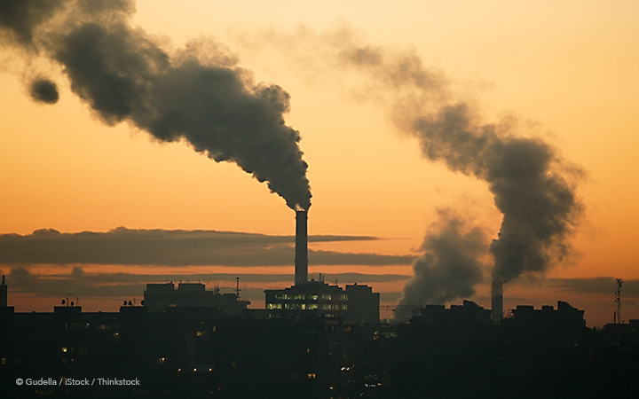
Externality Examples
Example 1
Example 3
© Gudella / iStock / Thinkstock
https://www.loc.gov/pictures/item/98507705/
Example 2
Example 4
© gilaxia / E+ / Getty Images
© santypan / iStock / Getty Images Plus

Slide 13
Negative Production Externality
Price
Marginal Social Cost (MSC)
Supply = Marginal Private Cost (MPC)
$12
DWL
$10
$8
Demand = Marginal Private Benefit (MPB)
Marginal Social Benefit (MSB)
Quantity
500
600

Slide 14
Positive Production Externality
Price
Supply = Marginal Private Cost (MPC)
Marginal Social Cost (MSC)
$400
DWL
$250
$100
Demand = Marginal Private Benefit (MPB)
Marginal Social Benefit (MSB)
10,000
15,000
Quantity

