Slide 1

Residential Redlining
© 2020, Federal Reserve Bank of St. Louis. Permission is granted to reprint or photocopy this presentation in its entirety for educational purposes provided the user credits the Federal Reserve Bank of St. Louis, www.stlouisfed.org/education.

Slide 2

Visual 1: How Does a Mortgage Work?
You take out a mortgage to borrow money; the house is the collateral.
You pay back the mortgage in full.
You fail to pay back the mortgage in full.
You own the house. Congratulations!
The lender owns the house and has the right to sell it to recover the unpaid part of the loan.
You must move out of the house.
In this type of sale the lender usually loses money.
You lose the money already paid to the lender.
© 2020, Federal Reserve Bank of St. Louis. Permission is granted to reprint or photocopy this presentation in its entirety for educational purposes provided the user credits the Federal Reserve Bank of St. Louis, www.stlouisfed.org/education.

Slide 3
Visual 2: HOLC Neighborhood Grades
Grade A: “Best” (shaded green), where properties were expected to increase or maintain a high appraised value. This grade represented the safest loans for lenders.
Grade B: “Still desirable” (shaded blue), where properties were expected to maintain their appraised value. This grade represented an acceptable risk for lenders.
Grade C: “Declining” (shaded yellow), where properties were expected to lose their appraised value. This grade represented an elevated risk for lenders.
Grade D: “Hazardous” (shaded red), where properties were old or close to unattractive or unhealthy industrial areas, therefore having minimal value. This grade represented a dangerous risk for lenders.
© 2020, Federal Reserve Bank of St. Louis. Permission is granted to reprint or photocopy this presentation in its entirety for educational purposes provided the user credits the Federal Reserve Bank of St. Louis, www.stlouisfed.org/education.

Slide 4
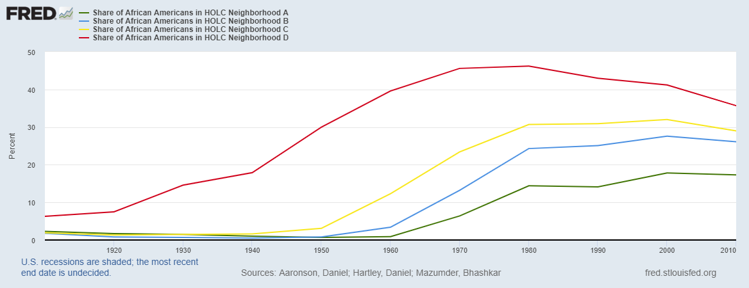
Visual 3: Shares of African Americans
Shares of African Americans in HOLC Neighborhoods
SOURCE: Aaronson, Hartley, and Mazumder via FRED®, Federal Reserve Bank of St. Louis
© 2020, Federal Reserve Bank of St. Louis. Permission is granted to reprint or photocopy this presentation in its entirety for educational purposes provided the user credits the Federal Reserve Bank of St. Louis, www.stlouisfed.org/education.

Slide 5
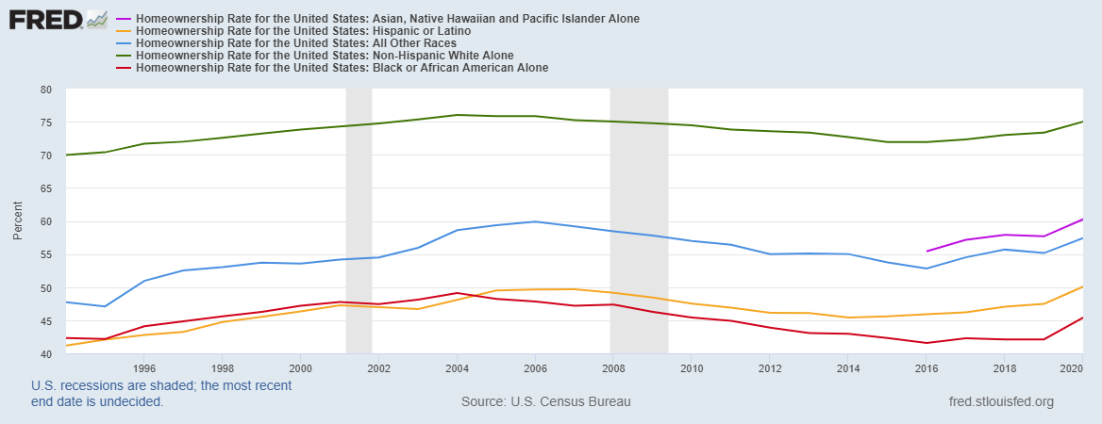
Visual 4: Homeownership Rates
Homeownership Rates by Race and Ethnic Group
SOURCE: U.S. Census Bureau via FRED®, Federal Reserve Bank of St. Louis
© 2020, Federal Reserve Bank of St. Louis. Permission is granted to reprint or photocopy this presentation in its entirety for educational purposes provided the user credits the Federal Reserve Bank of St. Louis, www.stlouisfed.org/education.

